Slide 1
Getting Started with Your Malnutrition Quality Improvement Project

Slide 2
Presentation Overview
Assess Your Facility’s Readiness
Assemble Your Team
Understand the Process for Malnutrition Quality Improvement
(QI)
Map Your Clinical Workflow
Select Your Quality Improvement Focus
Using a Plan-Do-Study-Act Approach to QI
3

Slide 3
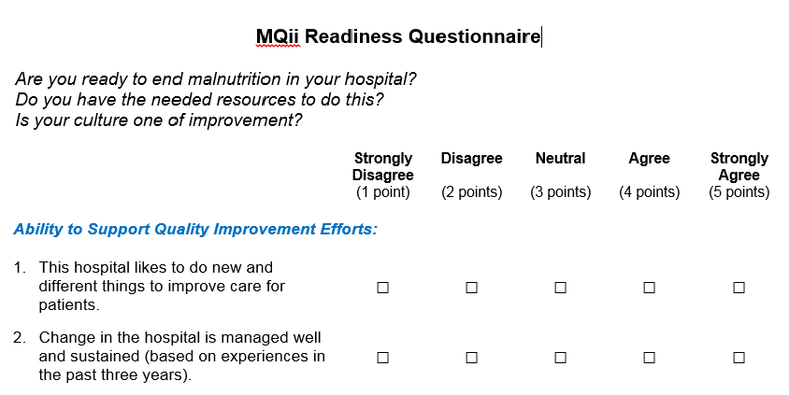
Assess Your Facility’s Readiness: Understand How to
Support Your Ability to Undertake Malnutrition QI
Use the Readiness Questionnaire to evaluate your facility’s readiness to undertake malnutrition quality improvement and initial steps to prepare for your project.
3

Slide 4
Assemble Your Team: Recommended Roles and
Responsibilities for Your Core Team
Member | Role | Suggestions | Est Time
Executive Sponsor | Hospital Leader to champion the effort from a leadership perspective, works to maintain executive leadership buy-in | Recommend Executive Sponsor and Project Champion establish regular meetings (i.e., monthly) to receive progress updates | 30 mins. per month to review progress and approach
Project Champion | Dietitian who generates support and buy-in for project by all relevant parties. Leads day-to-day efforts for this initiative. Develops processes for this project at site and spreads enthusiasm across hospital about the effort. Attends all educational webinars, participates in discussion boards and leads Toolkit implementation (e.g., leads clinician training). A nurse and/or physician may serve as a Co-champion. | Recommend Project Champion establish a team of champions (see next slide) and lead weekly “huddles” throughout this effort to discuss barriers and next steps. It might be useful to hold meetings twice a week. | 10 - 15 hours per month (depends on QI focus and resources)
IT/Informatics Representative | Assist with collecting and analyzing data elements required for eCQMs, length-of-stay, readmissions, and any other necessary data | Recommend maintaining regular communications with the Project Champion to ensure timely transmission of data | ~40 hours total to build eCQM report
25

Slide 5
Assemble Your Team: Value of Including Champions
for Each Role in the Care Team
Recommended | Value-Add | Est Time
Dietitian Champion | If the Project Champion is not a dietitian, we recommend engaging a dietitian leader who will champion this effort across dietitians and make sure targeted QI changes are adopted. It is also ideal to include a dietitian staff member on the team in addition to the dietitian project champion | 4 – 8 hours per month (Depends on QI focus)
Nurse Champion | Nurses are the first line of defense to identify malnourished patients. They also play a critical role in implementing interventions and discharge planning. It can be useful to have a nurse champion the value of this effort across nursing staff and make sure their nutrition care responsibilities are implemented effectively. | 4 – 8 hours per month (Depends on QI focus)
Physician Champion | Physicians play a critical role in implementing interventions, particularly when establishing a diagnosis and support optimal care coordination amongst members of the care team. We recommend securing support from a physician leader who will champion this effort and make sure targeted QI changes are adopted. | 4 – 8 hours per month (Depends on QI focus)

Slide 6
Assemble Your Team: Suggested Additional Team
Member
Recommended | Value-Add | Est Time
Quality Improvement Team Representative | A representative from your institution’s Quality Improvement Department/Committee should be identified to serve as a liaison responsible for the identification of existing quality improvement tools and resources within your institution to support implementation. | 1 hour a month to attend huddles

Slide 7
Understand the Process for Malnutrition Quality Improvement
Engage Your Project Team and Secure their
Commitment
Identify and Map Your Workflow and
Compare to Recommended Best Practices
Complete the Assessment and Decision Tool
Use the Output to Select your QI Focus and Intervention
Plan Your Implementation and Introduce the Changes

Slide 8
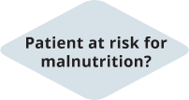
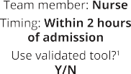
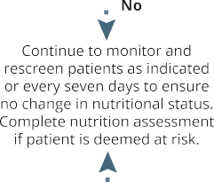
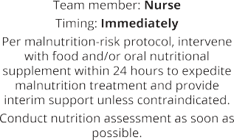
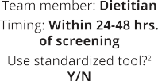
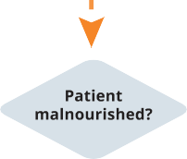
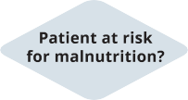
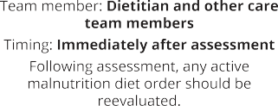
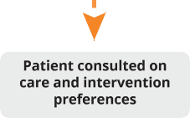
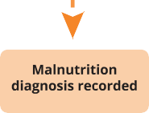
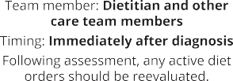
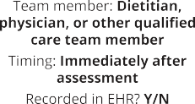
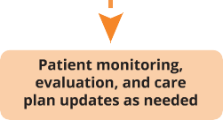
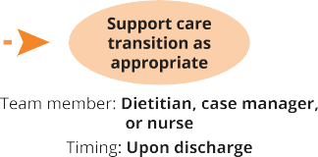
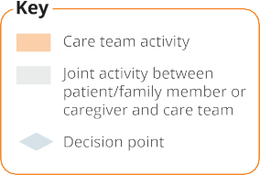
Map Your Clinical Workflow
8

Slide 9
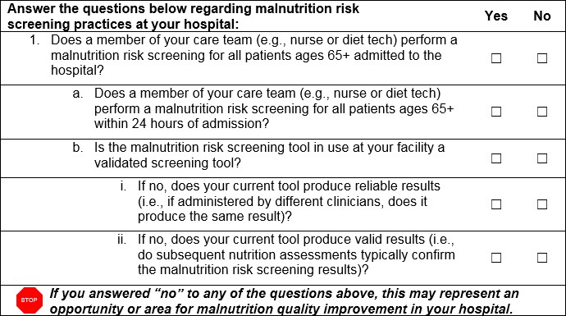
Select Your Malnutrition QI Intervention
Use the Care Assessment and Decision Tool to consider where opportunities for improvement exist, based on the results of your clinical workflow mapping
You can also use the electronic clinical quality measures (eCQMs) to collect baseline data
on your care processes and identify existing gaps in care delivery.
8

Slide 10
Using a PDSA Approach to QI Allows You to Pursue Improvements with Guidance from eCQM Data
Prepare for Engagement with Care Teams, Plan for Training
Getting Started Checklist
Care Assessment & Decision Tool
Malnutrition Clinical Workflow Template
Root Cause Analysis Guide
PDSA Cycle Templates
Train Care Teams on New Workflows or Documentation
Implementation Roadmap
MQii Project Charter
Plan
Do
Act
Study
Assess eCQM Performance to Identify Areas of Opportunity for Improvement
Sustainability Plan Template
Lessons Learned Log
Collect Performance Data to
Calculate eCQMs
o eCQM Specifications Manual
o eCQM Performance Calculator
o Lessons Learned Log
Each tool includes guidance on how and when your team is recommended to
use it to support QI decision-making and/or your QI implementation approach
PDSA: Plan-Do-Study-Act; QI: Quality Improvement
*Resources referenced can be found on the MQii website at: http://www.MQii.Today
10

Slide 11
Plan Do
MQii Tools To Support Participants’ QI Initiatives (1/2)
PROJECT MANAGEMENT TOOLS IN THE PLAN & DO STEPS OF THE PDSA CYCLE FOCUS ON SETTING UP YOUR QI INITIATIVE AND PROJECT TEAM
Each tool includes guidance on how and when it can be used to support you
with managing your QI intervention
Getting Started Checklist Outlines critical steps for beginning a malnutrition QI project | Malnutrition Clinical Workflow Template Allows you to map your current workflow and compare it to the recommended best practice workflow | Care Assessment & Decision Tool Guides your team’s understanding of the current state of malnutrition care
Root Cause Analysis Guide This will facilitate and allow you and your team to drill down to the root cause and find optimal solutions | PDSA Cycle Templates After you assess your progress the PDSA cycle will help you prepare and take any next steps
“Plan” Resources
Implementation Roadmap
Recommends actions for your implementation period, including expected outcomes and suggested timing
MQii Project Charter*
Planning tool to be completed with your team as you work through the Implementation Roadmap
“Do” Resources
QI: Quality Improvement
*Tools referenced can be found on the MQii website at: http://www.MQii.Today

Slide 12
Study Act
MQii Tools To Support Participants’ QI Initiatives
PROJECT MANAGEMENT TOOLS IN THE STUDY & ACT STEPS OF THE PDSA CYCLE FOCUS ON IMPLEMENTATION, COLLECTING AND ANALYZING DATA
Each tool includes guidance on how and when it can be used to support you
with managing your QI intervention
eCQM Specifications Manual
Provides you with guidance for how to implement the four malnutrition eCQMs
Lessons Learned Log*
Provides a template for documenting the lessons learned over the course of your QI implementation
Sustainability Plan Template *
Guides you with development of a plan for short- and long- term strategies for sustaining improvements
eCQM Performance Calculator*
Allows you to use your extracted EHR data to calculate your hospital’s eCQM performance
Lessons Learned Log*
Allows you to use those lessons logged during implementation to extract insights and identify potential modifications that may be made to your project
“Study” Resources
“Act” Resources
QI: Quality Improvement
*Tools referenced can be found on the MQii website at: http://www.MQii.Today

Slide 13
Data Collection Will be Critical to Implementation
Engage Your IT Team and Secure their
Commitment
Identify and Map Data Elements & Build eCQM report
Run Report and Evaluate Performance Use the Report to Measure Progress
Refine the Report as Needed to Align with Your MQii Goals

